Slide 1
CHAPTER 5 Establishing the business requirements

Slide 2
Objectives
Understanding the business requirements and how to define them.
Student should enhance the structure of vision and scope document, a deliverable that contains the project’s business requirements
Student could write the vision and scope about project through using vision statement and scope representation techniques.
Understanding the vision and scope on agile project

Slide 3
Contents
Business requirements
Identifying desired business benefits
Business objectives and opportunities
Scope representation techniques
Context diagram
Ecosystem map
Feature tree
Event list
Keeping the scope in focus
Vision and scope on agile project

Slide 4
Business requirements
Identifying desired business benefits
Product vision and project scope
Conflicting business requirements

Slide 5
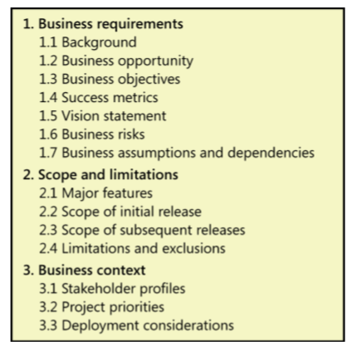
Vision and scope document
Notes:
Teacher should explain every section in this template (what/why/how)

Slide 6
Scope representation techniques
Context diagram
Ecosystem map
Feature tree
Event list

Slide 7
Keeping the scope in focus
Using business objectives to make scoping decisions
Assessing the impact of scope changes

Slide 8
Vision and scope on agile projects
Emphasizing the differences between agile projects and other projects.

